Slide 1
2.6 Character Codes
Calculations aren’t useful until their results can be displayed in a manner that is meaningful to people.
We also need to store the results of calculations, and provide a means for data input.
Thus, human-understandable characters must be converted to computer-understandable bit patterns using some sort of character encoding scheme.

Slide 2
Characters
Characters code

Slide 3
2.6 Character Codes
As computers have evolved, character codes have evolved.
Larger computer memories and storage devices permit richer character codes.
The earliest computer coding systems used six bits.
Binary-coded decimal (BCD) was one of these early codes. It was used by IBM mainframes in the 1950s and 1960s.

Slide 4
2.6 Character Codes
In 1964, BCD was extended to an 8-bit code, Extended Binary-Coded Decimal Interchange Code (EBCDIC).
EBCDIC was one of the first widely-used computer codes that supported upper and lowercase alphabetic characters, in addition to special characters, such as punctuation and control characters.
EBCDIC and BCD are still in use by IBM mainframes today.

Slide 5
2.6 Character Codes
Other computer manufacturers chose the 7-bit ASCII (American Standard Code for Information Interchange) as a replacement for 6-bit codes.
While BCD and EBCDIC were based upon punched card codes, ASCII was based upon telecommunications (Telex) codes.
Until recently, ASCII was the dominant character code outside the IBM mainframe world.

Slide 6
2.6 Character Codes
Many of today’s systems embrace Unicode, a 16-bit system that can encode the characters of every language in the world.
The Java programming language, and some operating systems now use Unicode as their default character code.
The Unicode code space is divided into six parts. The first part is for Western alphabet codes, including English, Greek, and Russian.

Slide 7
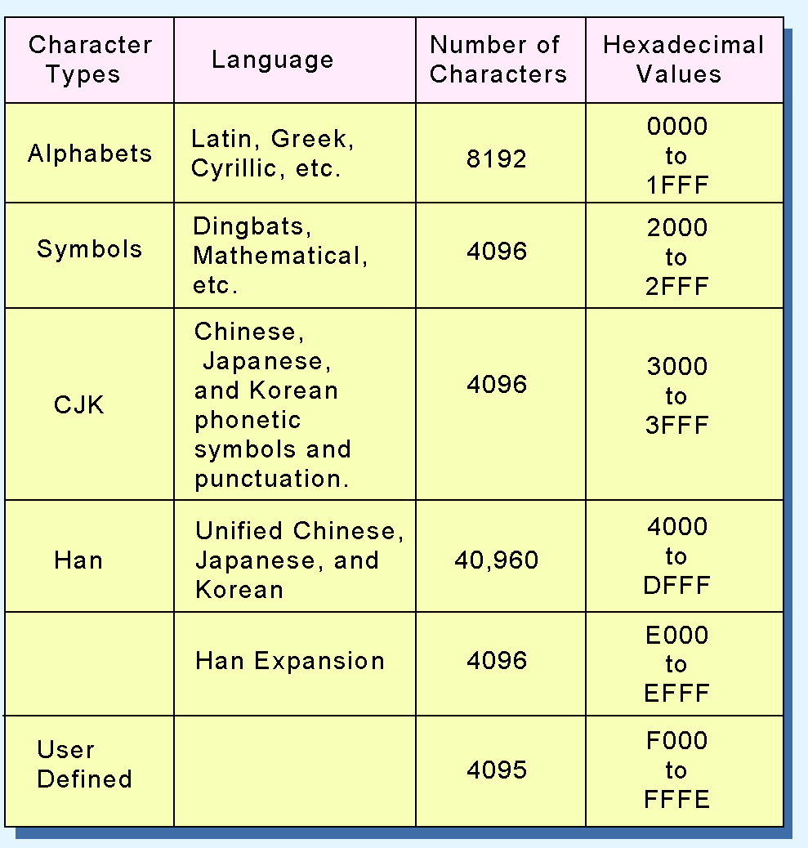
2.6 Character Codes
The Unicode codes- pace allocation is shown at the right.
The lowest-numbered Unicode characters comprise the ASCII code.
The highest provide for user-defined codes.

